Slide 1
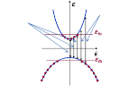
DEPARTMENT OF PHYSICS
SRM INSTITUTE OF SCIENCE AND TECHNOLOGY
18PYB103J – Physics: Semiconductor Physics
Module – III (Lecture S9 – SLO 1 & 2)
Optical Gain and Optical Loss
18PYB103J Module 3 Lecture 1
1

Slide 2
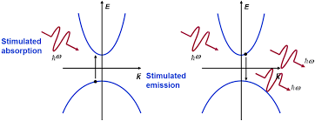
Optical Gain and Loss in semiconductor
Optical Gain in semiconductor defines the stimulated emission associated with light emission created by recombination of electrons and holes.
Optical Loss in semiconductor defines the stimulated absorption associated with light absorption created by generation of electrons and holes.
18PYB103J Module 3 Lecture 1

Slide 3
In a semiconductor crystal, consider an electron initially occupies a single state and makes a transition to one of a large number of final states due to photon interaction.
The electron-photon interactions in the crystal is characterized by Fermi’s Golden Rule and gives the transition rate for a single pair of conduction and valence band states.
Each downward transition generates one photon and upward transition absorbs one photon.
18PYB103J Module 3 Lecture 1

Slide 4
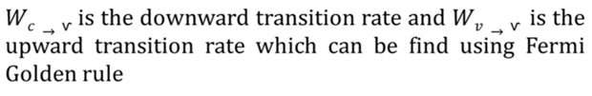
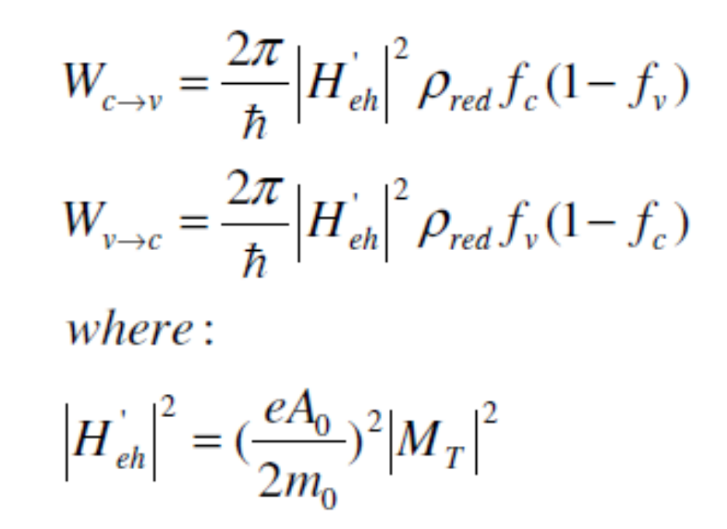
Where H’ is time dependent perturbation to the original Hamiltonian, It is to induce electronic transition between conduction and valence band. f_{v} and f_{c} the Fermi distribution and ρ_{red} is reduced density of state.
18PYB103J Module 3 Lecture 1

Slide 5
Explanation for Optical Gain
Optical gain in semiconductor is caused by photon-induced transitions of electrons from the conduction band to the valence band
Optical gain in the material is attained when we inject a carrier density beyond N_{tr} such that the quasi-Fermi levels are separated by an energy greater than the band gap.
If the number of downward transition per seconds exceeds the number of upward transition, there will be a net generation of photons, and optical gain can be achieved.
18PYB103J Module 3 Lecture 1

Slide 6
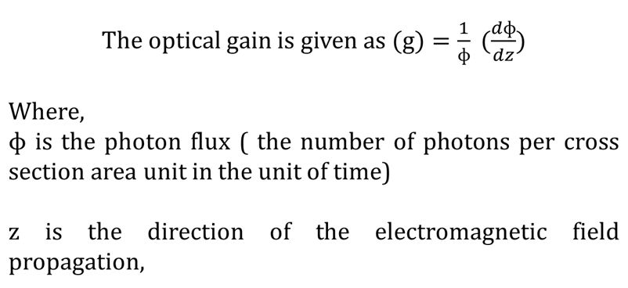

18PYB103J Module 3 Lecture 1

Slide 7
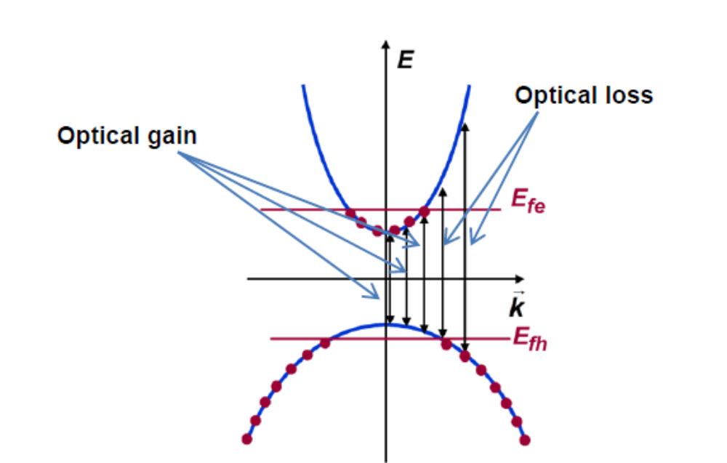
18PYB103J Module 3 Lecture 1

Slide 8
The optical gain experienced by an incoming photon is very much dependent on the photon’s energy.
From the figure, Given a value for the Fermi level splitting, optical frequencies for which Eg < ħ𝜔 < E_{fe}-E_{fh} experience optical gain
The condition Eg < ħ𝜔 < E_{fe}-E_{fh} is the condition for population inversion and can be realized if, for example, electrons are removed from the valence band and placed in the conduction band.
The light loss coefficient α(ω) for optical gain is less than zero or negative
18PYB103J Module 3 Lecture 1

Slide 9
Explanation for Optical Loss
Optical gain in semiconductor is caused by photon-induced transitions of electrons from the valence band to the conduction band
Optical loss in the material is attained when we inject a carrier density beyond N_{tr} such that the quasi-Fermi levels are separated by an energy greater than the band gap.
If the number of upward transition per seconds exceeds the number of downward transition, there will be a net absorption of photons, and optical loss can be achieved.
18PYB103J Module 3 Lecture 1

Slide 10
18PYB103J Module 3 Lecture 1

Slide 11
From the figure, Given a value for the Fermi level splitting, optical frequencies for which Eg > ħ𝜔, E_{fe}-E_{fh} experience optical loss
The condition Eg < ħ𝜔, E_{fe}-E_{fh} is the condition for stimulated absorption and can be realized if, for example, electrons are removed from the conduction band and placed in the valence band.
The light loss coefficient α(ω) for optical loss is greater than zero or positive
18PYB103J Module 3 Lecture 1

